Slide 1
Chapter 5: Availability
Pingjian Zhang
School of Software Engineering, SCUT
2018

Slide 2
Chapter Outline
What is Availability?
Availability General Scenario
Tactics for Availability
A Design Checklist for Availability
Summary

Slide 3
系统能用才是硬道理
2014年X银行，2015年Y银行，系统崩溃
2015年4月份中登系统崩溃
2015年7月份美国签证系统崩溃
2016年6月份阿里淘宝崩溃
2017年2月份手机百度崩溃
2017年8月份微信崩溃
2018年春晚直播期间淘宝崩溃
2018年美国国税局报税系统崩溃

Slide 4
What is Availability?
Availability refers to a property of software that it is there and ready to carry out its task when you need it to be.
This is a broad perspective and encompasses what is normally called reliability.
Availability builds on reliability by adding the notion of recovery (repair).
Fundamentally, availability is about minimizing service outage time by mitigating faults.

Slide 5
Availability Measure
α = MTBF/(MTBF + MTTR)
Availability | Downtime/Year
99% | 3 days, 15.6 hours
99.9% | 8 hours, 0 miniutes, 46 seconds
99.99% | 52miniutes, 34 seconds
99.999% | 5 miniutes, 15 seconds
99.9999% | 32 seconds

Slide 6
Availability General Scenario
Portion of Scenario | Possible Values
Source | Internal/external: people, hardware, software, physical infrastructure, physical environment
Stimulus | Fault: omission, crash, incorrect timing, incorrect response
Artifact | System’s processors, communication channels, persistent storage, processes
Environment | Normal operation, startup, shutdown, repair mode, degraded operation, overloaded operation
Response | Prevent the fault from becoming a failure Detect the fault: log the fault notify appropriate entities (people or systems) Recover from the fault disable source of events causing the fault be temporarily unavailable while repair is being effected fix or mask the fault/failure or contain the damage it causes operate in a degraded mode while repair is being effected
Response Measure | Time or time interval when the system must be available Availability percentage (e.g. 99.999%) Time to detect the fault Time to repair the fault Time or time interval in which system can be in degraded mode Proportion (e.g., 99%) or rate (e.g., up to 100 per second) of a certain class of faults that the system prevents, or handles without failing

Slide 7
Sample Concrete Availability Scenario
The heartbeat monitor determines that the server is nonresponsive during normal operations. The system informs the operator and continues to operate with no downtime.

Slide 8
Goal of Availability Tactics
A failure occurs when the system no longer delivers a service consistent with its specification
A fault (or combination of faults) has the potential to cause a failure.
Availability tactics enable a system to endure faults so that services remain compliant with their specifications.
The tactics keep faults from becoming failures or at least bound the effects of the fault and make repair possible.

Slide 9
Goal of Availability Tactics

Slide 10
Availability Tactics

Slide 11
Detect Faults
Ping/echo: asynchronous request/response message pair exchanged between nodes, used to determine reachability and the round-trip delay through the associated network path.
Monitor: a component used to monitor the state of health of other parts of the system. A system monitor can detect failure or congestion in the network or other shared resources, such as from a denial-of-service attack.
Heartbeat: a periodic message exchange between a system monitor and a process being monitored.
Notes:
Ping/echo: cluster manager, load balancer
Monitor: TCP congestion control
Heartbeat: watchdog; nodes join/leave freely and randomly; ATM

Slide 12
Detect Faults
Timestamp: used to detect incorrect sequences of events, primarily in distributed message-passing systems.
Sanity Checking: checks the validity or reasonableness of a component’s operations or outputs; typically based on a knowledge of the internal design, the state of the system, or the nature of the information under scrutiny.
Condition Monitoring: checking conditions in a process or device, or validating assumptions made during the design.
Notes:
Sanity Checking: interface/information flow
Condition Monitoring:对特定条件进行检测，比如检验和

Slide 13
Detect Faults
Voting: to check that replicated components are producing the same results.
Exception Detection: detection of a system condition that alters the normal flow of execution.
Self-test: procedure for a component to test itself for correct operation.
Notes:
Special voting: Replication (clones of each other), Functional Redundancy (different design/implementation)
解析余度法:通过解析模型与实测信号的残差来检测错误, even allows different inputs
Parameter fence: special pattern after variable-length parameters to detect memory overwriting
Parameter typing: strong typing favors availability against modifiability.
Timeout

Slide 14
Recover from Faults (Preparation & Repair)
Active Redundancy (hot spare): all nodes in a protection group receive and process identical inputs in parallel, allowing redundant spare(s) to maintain synchronous state with the active node(s).
Passive Redundancy (warm spare): only the active members of the protection group process input traffic; one of their duties is to provide the redundant spare(s) with periodic state updates.
Spare (cold spare): redundant spares of a protection group remain out of service.
Notes:
A protection group is a group of nodes where one or more nodes are “active,” with the remainder serving as redundant spares.

Slide 15
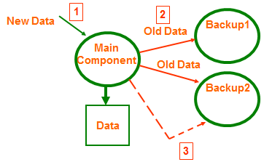
New Data
Main Component
Standby
Active Redundancy
Passive Redundancy

Slide 16
Recover from Faults (Preparation & Repair)
Exception Handling: dealing with the exception by reporting it or handling it, potentially masking the fault by correcting the cause of the exception and retrying.
Rollback: revert to a previous known good state, referred to as the “rollback line”.
Software Upgrade: in-service upgrades to executable code images in a non-service-affecting manner.
Notes:
Software Upgrade: dll/so

Slide 17
Recover from Faults (Preparation & Repair)
Retry: where a failure is transient retrying the operation may lead to success.
Ignore Faulty Behavior: ignoring spurious messages.
Degradation: maintains the most critical system functions, dropping less critical functions.
Reconfiguration: reassigning responsibilities to the resources still functioning, while maintaining as much functionality as possible.
Notes:
Retry: in network or sever farms
Ignore Faulty Behavior: ignore fault DNS messages by ACL
resources left functioning: resources still functioning

Slide 18
Recover from Faults (Reintroduction)
Shadow: operating a previously failed or in-service upgraded component in a “shadow mode” for a predefined time prior to reverting the component back to an active role.
State Resynchronization: partner to active redundancy and passive redundancy where state information is sent from active to standby components.
Escalating Restart: recover from faults by varying the granularity of the component(s) restarted and minimizing the level of service affected.
Non-stop Forwarding: functionality is split into supervisory and data. If a supervisor fails, a router continues forwarding packets along known routes while protocol information is recovered and validated.
Notes:
Shadow: runs before put into service for monitoring correctness
State Resynchronization: checksum/MD5 for active redundancy and checkpoint otherwise
Escalating Restart: add functionalities one by one

Slide 19
Prevent Faults
Removal From Service: temporarily placing a system component in an out-of-service state for the purpose of mitigating potential system failures
Transactions: bundling state updates so that asynchronous messages exchanged between distributed components are atomic, consistent, isolated, and durable.
Predictive Model: monitor the state of health of a process to ensure that the system is operating within nominal parameters; take corrective action when conditions are detected that are predictive of likely future faults.
Notes:
Predictive Model: monitor the usage of resources

Slide 20
Prevent Faults
Exception Prevention: preventing system exceptions from occurring by masking a fault, or preventing it via smart pointers, abstract data types, wrappers.
Increase Competence Set: designing a component to handle more cases—faults—as part of its normal operation.

Slide 21
Design for Availability
Adopt suitable architectural patterns and tactics.
Establish an availability model/formulae.
Design a dedicated availability view if necessary.

Slide 22
Design for Availability
Determine the system responsibilities that need to be highly available. Ensure that additional responsibilities have been allocated to detect a fault.
Ensure that there are responsibilities to:
log the fault
notify appropriate entities (people or systems)
disable source of events causing the fault
be temporarily unavailable
fix or mask the fault/failure
operate in a degraded mode

Slide 23
Case Study: Kafka High Availability
Kafka是由LinkedIn开发的一个分布式的消息系统，使用Scala编写，它以可水平扩展和高吞吐率而被广泛使用。目前越来越多的开源分布式处理系统如Cloudera、Apache Storm、Spark都支持与Kafka集成。

Slide 24
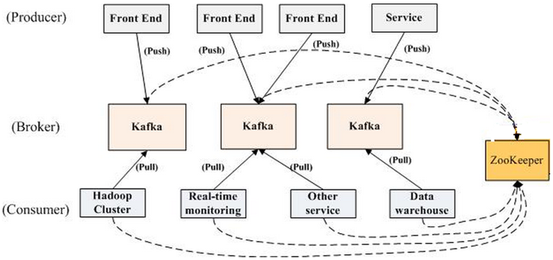
Case Study: Kafka High Availability

Slide 25
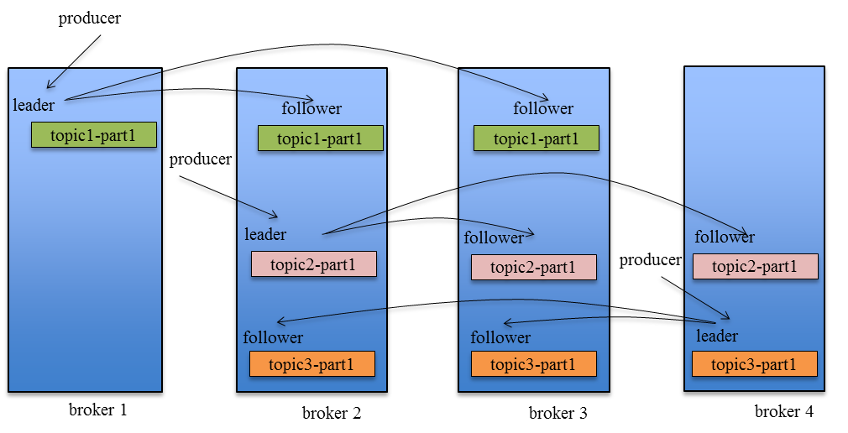
Case Study: Kafka High Availability

Slide 26
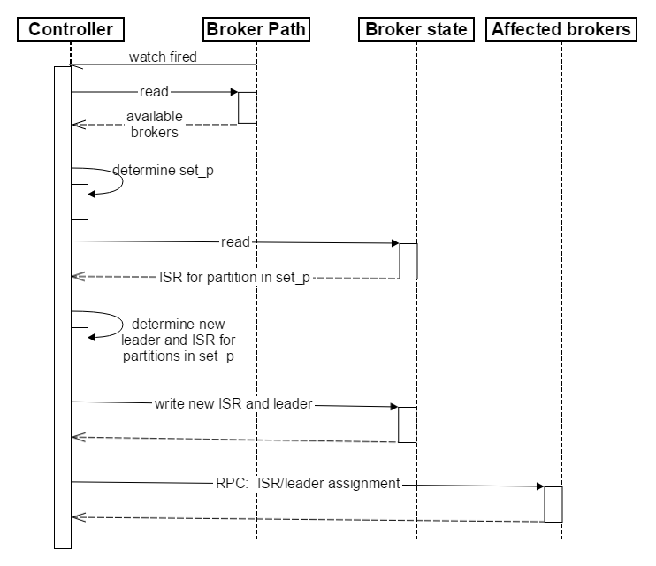
Case Study: Kafka High Availability

Slide 27
StackOverflow 这么大，它的架构是怎么样的？
负载均衡器收到的 HTTP 请求：209,420,973

Slide 28
4 台 Microsoft SQL Server 服务器（其中 2 台使用了新的硬件）
11 台 IIS Web 服务器（新的硬件）
2 台 Redis 服务器（新的硬件）
3 台标签引擎服务器（其中 2 台使用了新的硬件）
3 台 Elasticsearch 服务器（同上）
4 台 HAProxy 负载均衡服务器（添加了 2 台，用于支持 CloudFlare）
2 台网络设备（Nexus 5596 核心 + 2232TM Fabric Extender，所有设备都升级到 10Gbps 带宽）
2 台 Fortinet 800C 防火墙（取代了 Cisco 5525-X ASAs）
2 台 Cisco ASR-1001 路由器（取代了 Cisco 3945 路由器）
2 台 Cisco ASR-1001-x 路由器（新的！）

Slide 29
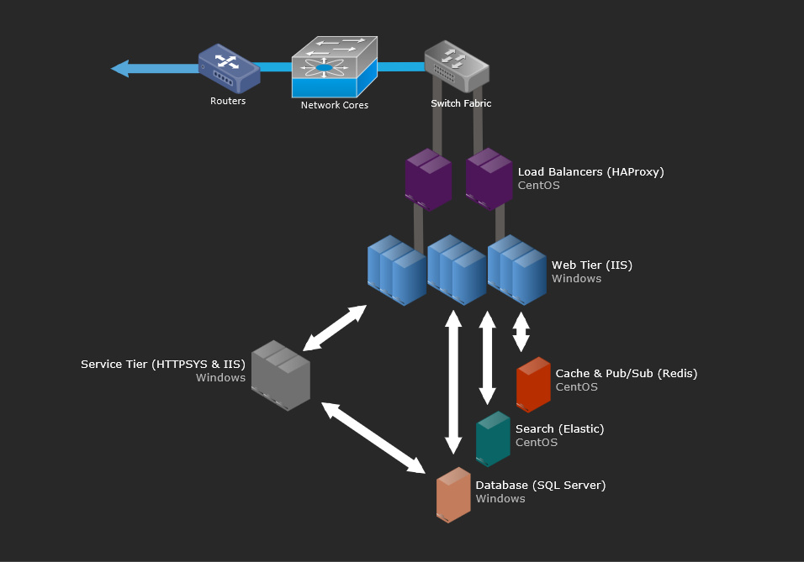

Slide 30
Summary
Availability refers to the ability of the system to be available for use when a fault occurs.
The fault must be recognized (or prevented) and then the system must respond.
The response will depend on the criticality of the application and the type of fault
can range from “ignore it” to “keep on going as if it didn’t occur.”

Slide 31
Summary
Tactics for availability are categorized into detect faults, recover from faults and prevent faults.
Detection tactics depend on detecting signs of life from various components.
Recovery tactics are retrying an operation or maintaining redundant data or computations.
Prevention tactics depend on removing elements from service or limiting the scope of faults.
All availability tactics involve the coordination model.

